Slide 1
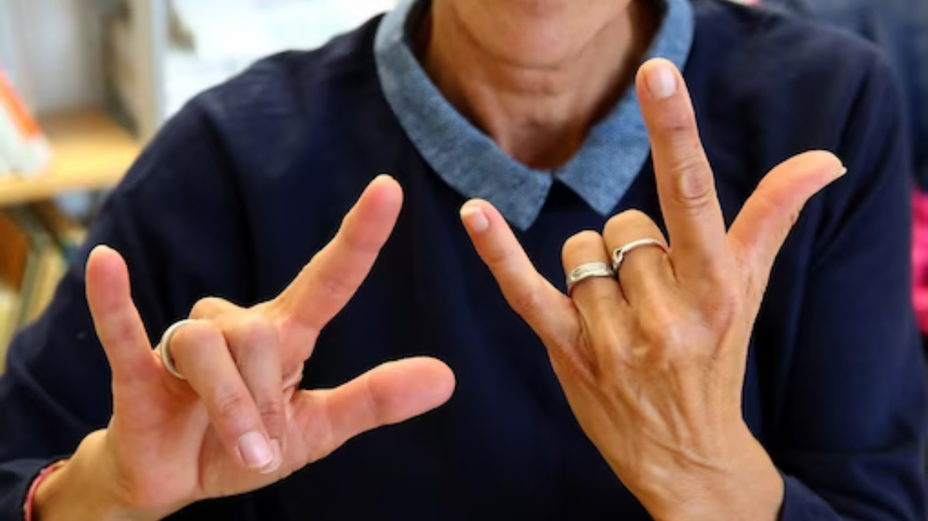
Learning app for Deaf and Mute and sign language English to Gujarati Converter
- Bridging the Communication Gap
Supervisor : Team :
Mrs. B Sonal Abhinay Srikanth K 1608-21-733-149
Md. Abdul Rahman 1608-21-733-319
B. Kiran Kumar 1608-21-733-192

Slide 2

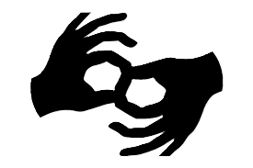
Abstract
AI-powered mobile app for Indian Sign Language (ISL) learning with gesture-to-text translation and offline accessibility.
On-device machine learning using TensorFlow Lite (TFLite) or MediaPipe ensures real-time sign recognition without internet dependency.
Structured and scalable learning system that progresses from basic alphabets to complex gestures, supporting English and Gujarati translations.

Slide 3
Introduction
Indian Sign Language (ISL) lacks widespread adoption and awareness, and existing ISL apps are often incomplete, outdated, or not user-friendly, unlike the many well-developed American Sign Language (ASL) applications.
Current solutions rely on static images and videos, lacking real-time interactive learning and an integrated gesture recognition system tailored for ISL.
This project introduces a structured learning framework with real-time gesture recognition to enhance accessibility and improve the ISL learning experience.

Slide 4
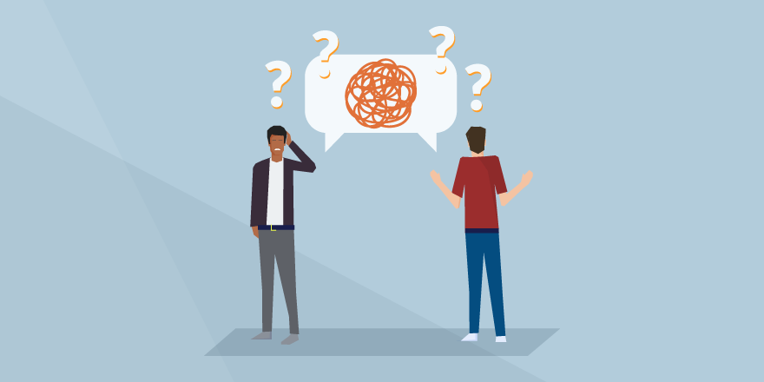
Motivation : Why this research?
Current ISL learning tools lack interactive, personalized, and AI-powered features, limiting accessibility and real-time gesture recognition.
The research aims to create a comprehensive AI-based platform for teaching ISL and enabling real-time communication assistance.
ISL is often neglected compared to ASL, and the development of a high-quality ISL learning app is crucial for improving communication within India's diverse linguistic landscape.

Slide 5
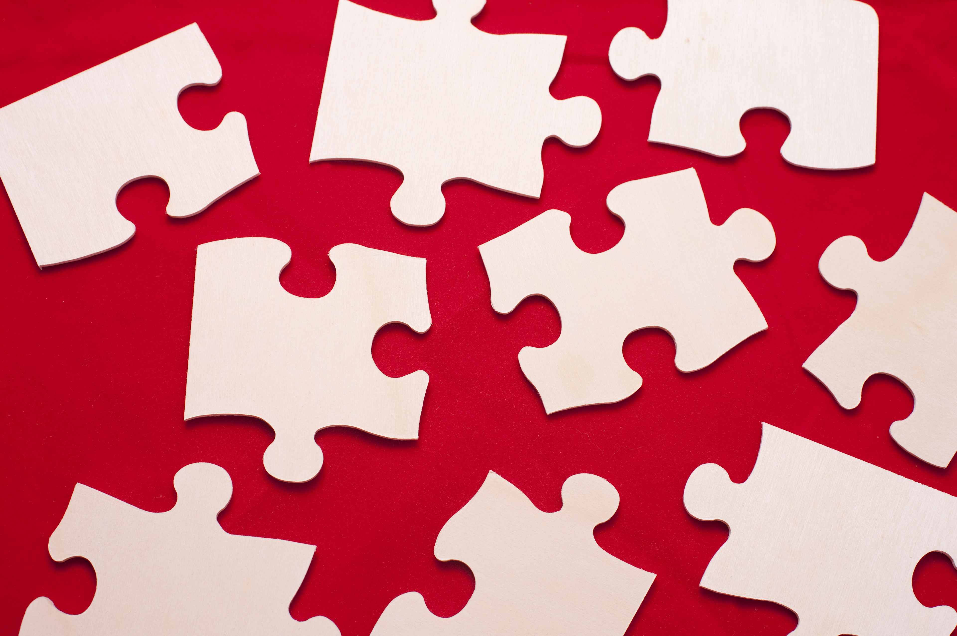
Problem in Existing Methods
Existing ISL tools are limited by their static, unimodal learning methods and lack of real-time interaction and AI integration.
There is no adaptive learning approach, offline accessibility, or standardized platform for ISL, making it less effective for diverse learners.
A comprehensive, interactive, and continuously updated ISL learning platform is needed to improve accessibility and learning outcomes..

Slide 6
Objectives of the Project
AI-Powered Learning and Real-Time Feedback - Develop a structured ISL learning platform that integrates gesture-to-text conversion and real-time AI-powered feedback using gesture recognition models like TFLite or MediaPipe, ensuring an interactive and personalized learning experience.
Enhanced Accessibility and Cross-Platform Support - Provide offline functionality through local storage (SQLite) and cloud-based synchronization via Firebase , allowing users to access their progress across multiple devices seamlessly, even in areas with limited internet connectivity.
Comprehensive, Engaging, and Adaptive Learning - Create a interactive learning experience while implementing an AI-based gesture recognition system from camera.

Slide 7



Methodology-
System Architecture
Presentation Layer:
Android mobile UI (Kotlin/XML) for user interaction.
1
Processing Layer:
On-device ML model (TFLite/MediaPipe) for gesture detection
and translation.
2
Data Layer:
Uses SQLite for offline storage and Firebase for
cloud sync.
3

Slide 8
Methodology-
Backend Module
1. Data Collection & Preprocessing:
Curated ISL gesture images and videos.
Image preprocessing techniques applied (e.g., noise reduction, augmentation).
2. Feature Extraction & Model Development:
ML models trained on gesture images for classification and recognition.
Fusion of visual and text-based feedback.
3. Training & Evaluation:
The system is evaluated using accuracy, precision, and recall metrics.

Slide 9
Methodology-
Frontend Module
Home Screen
Categories: Basic Signs, Common Phrases, Advanced Gestures
Live Gesture Capture button for real-time recognition
Learning Module
Select signs with gesture illustrations and text translations
Camera mode for users to mimic gestures with instant feedback
Live Gesture Recognition
Real-time sign recognition using camera
AI provides instant feedback on accuracy with translations

Slide 10
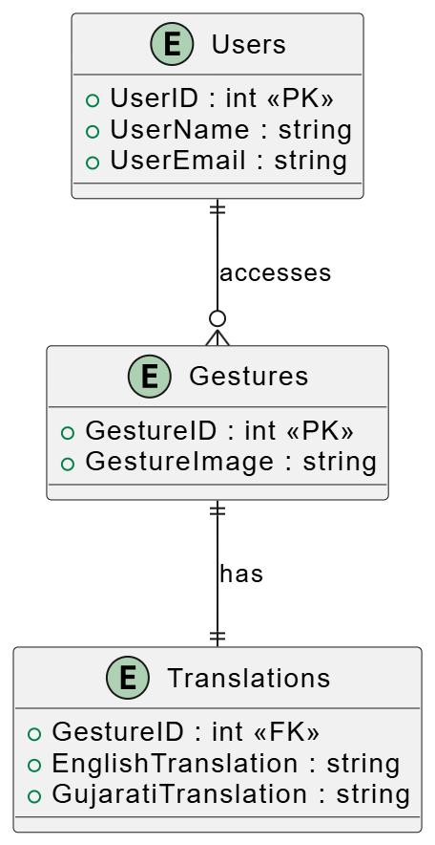
Data Flow Diagrams –
Entity Relationship Diagram

Slide 11
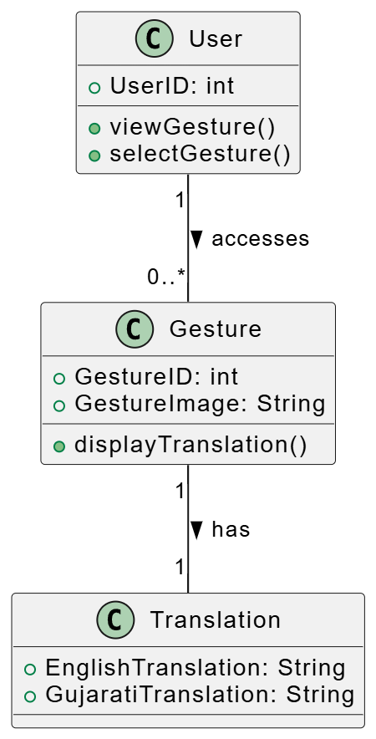
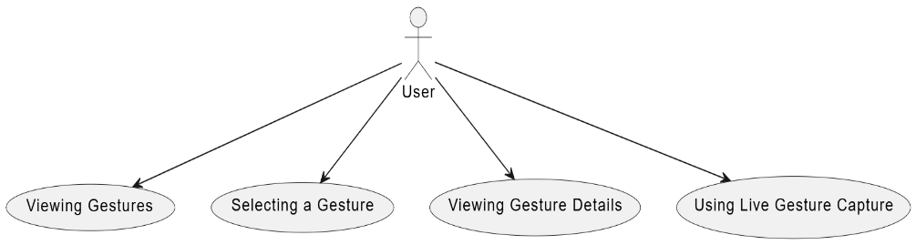
Use Case Diagram Class Diagram

Slide 12
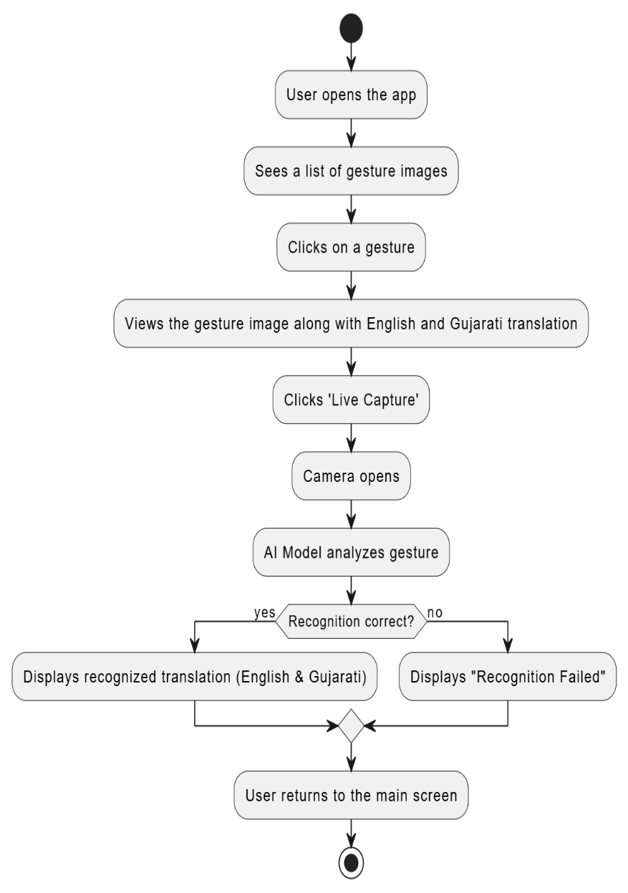
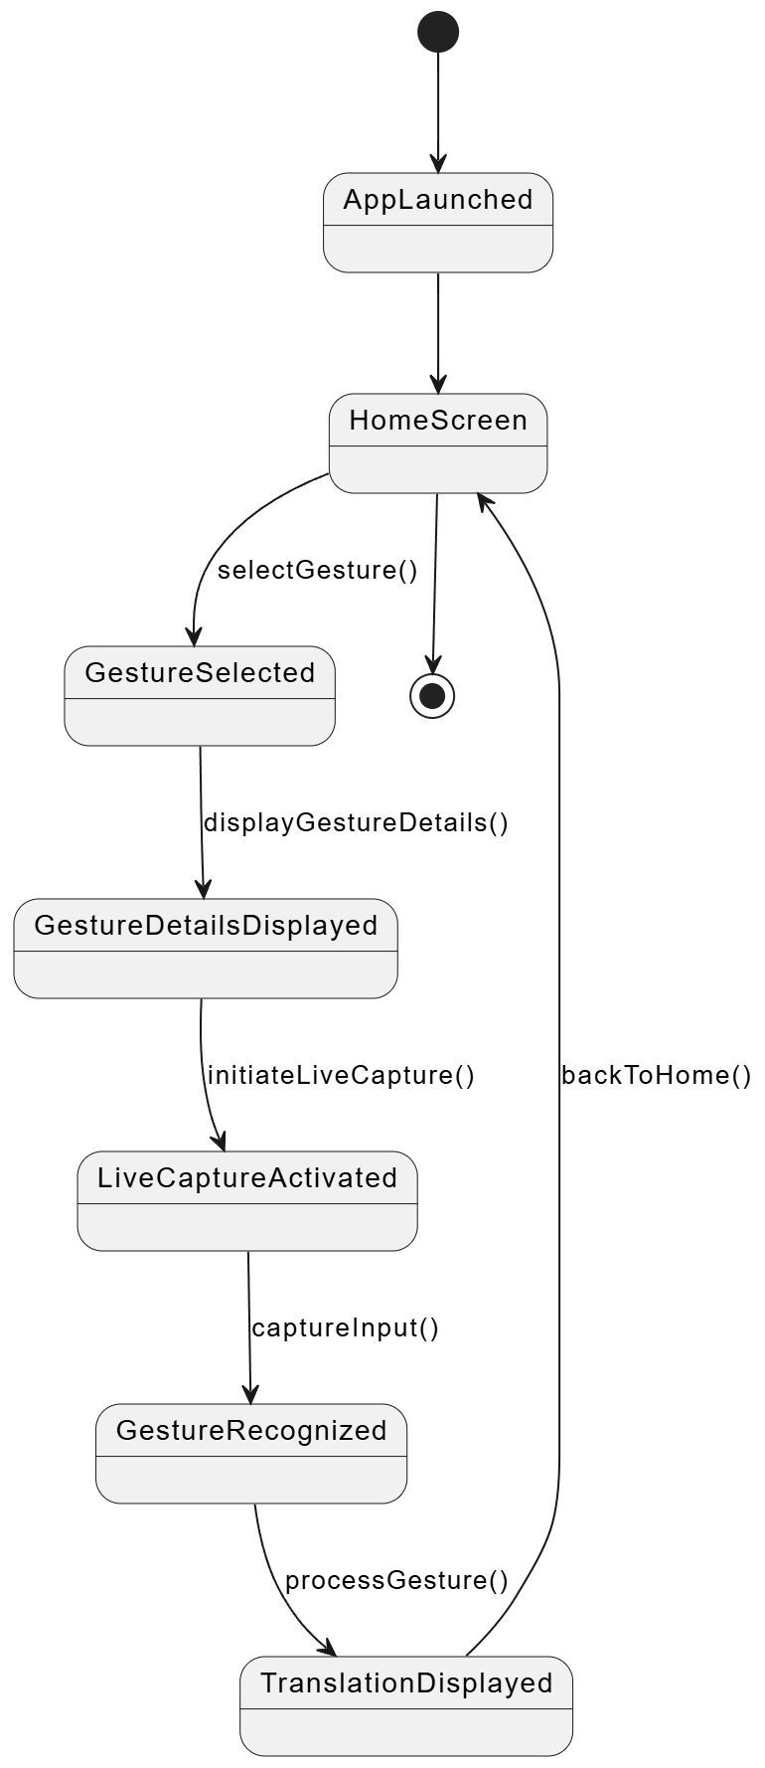
Activity Diagram
State Diagram

Slide 13
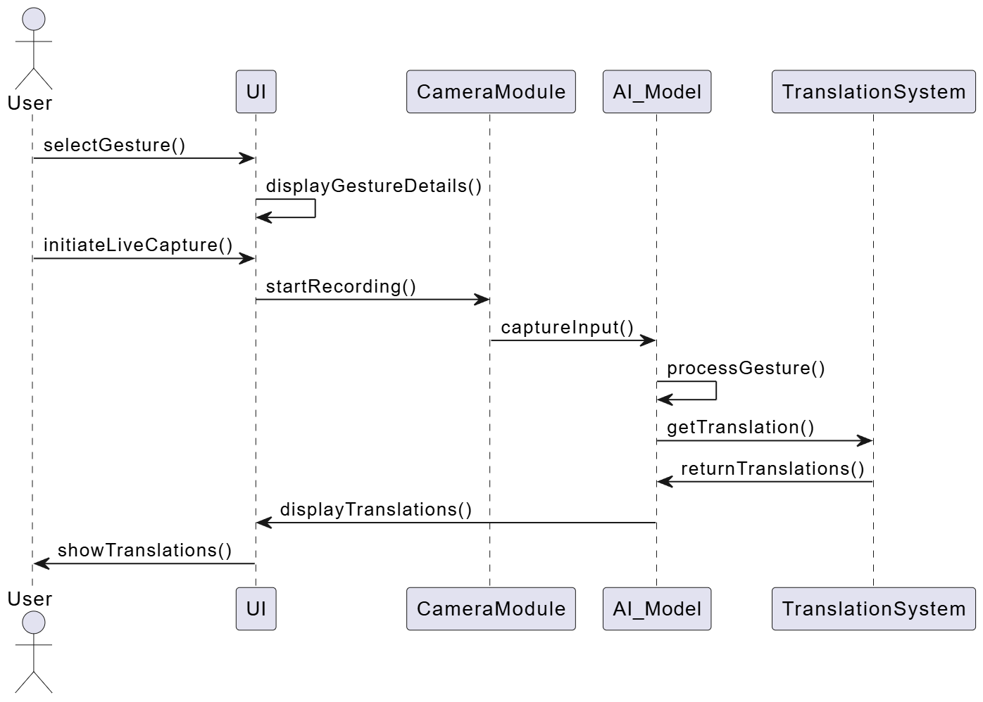
Sequence Diagram

Slide 14
Planning of Work and Project Timeline
Gantt Chart
Task | Week 1-4 | Week 5-9 | Week 10-13 | Week 14-17 | Week 18-20
Research & Data Collection | ████████
Model Training & Optimization |  | ████████
Integration with Mobile App |  |  | ████████
Testing & Debugging |  |  |  | ████████
Deployment & Final Report |  |  |  |  | ████████

Slide 15
Phases of Project
1
Research & Data Collection (Week 1 - 4)
2
Model Development (Week 5 - 9)
3
System Integration & Optimization (Week 10 - 13)
4
Testing & Debugging (Week 14 - 17)
3
Deployment & Documentation (Week 18 - 20)

Slide 16
Project Scope
1
ISL to English & Gujarati
2
Learning offline
Gesture images.
Live Gesture Capture
3
Camera.

Slide 17
Conclusion
1
2
3
ISL is underrepresented in digital learning, and AI-powered gesture recognition improves its accessibility and effectiveness.
The integration of structured learning modules and offline accessibility boosts user engagement and usability in low-connectivity areas.
This project represents a technological innovation that promotes social inclusivity, with future improvements focused on scalability, accuracy, and multilingual support for a wider audience.

Slide 18
Future Enhancements
1
Expanding ISL Library
2
Gamified Learning
Quizzes and tests.
3
Globalized version
Multilingual app.

